Slide 1

CT-216
CONVOLUTIONAL CODES
Presented By :
Lab Group 3 Sub-group 1
DAIICT | 2024

Slide 2
Honor Code
We declare that,
The work we are presenting here is our own work, that we have done in a group.
We have not copied any part of the whole code or result from someone's code or codes given on the internet.
Concepts, understanding and insights we will be describing are our own.
We make this pledge truthfully. We know that violation of this solemn pledge can carry grave consequences.
Wherever we have relied on an existing work that is not our own, we have provided a proper reference citation.
DAIICT | 2024

Slide 3

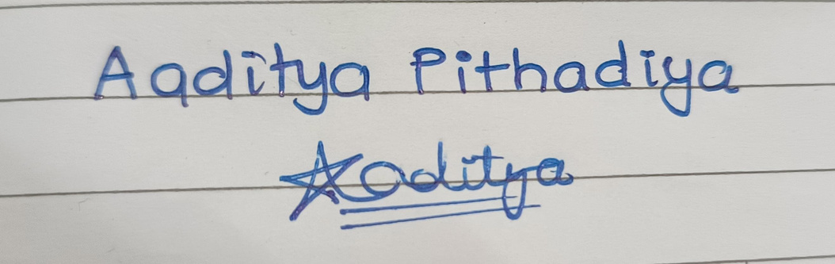
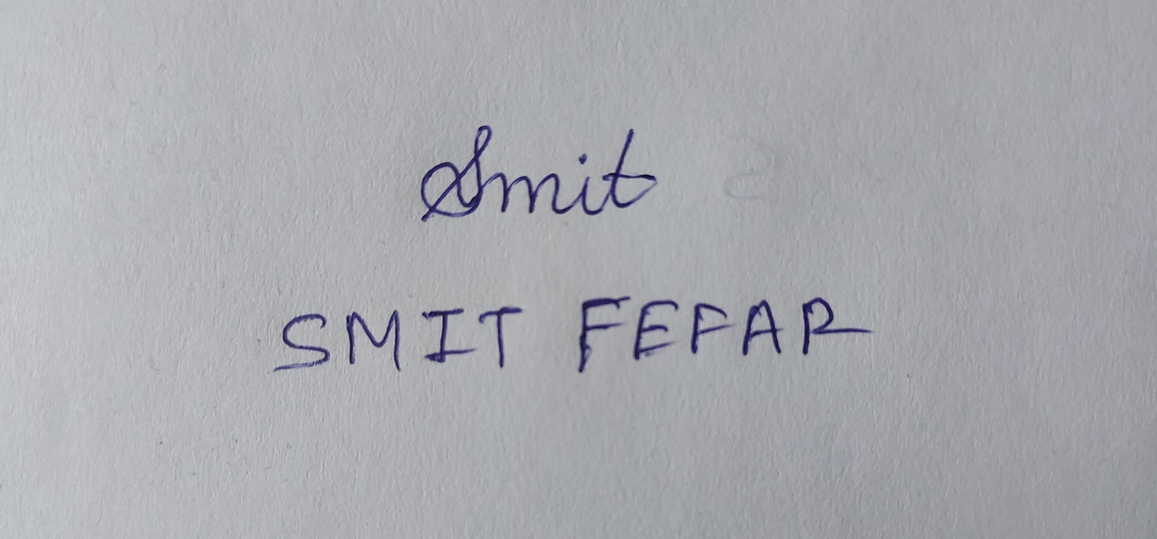
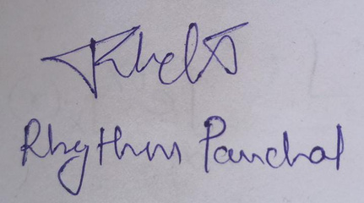

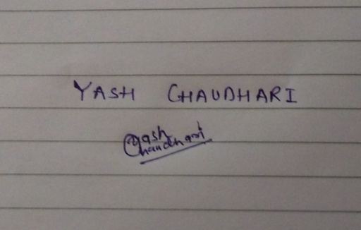

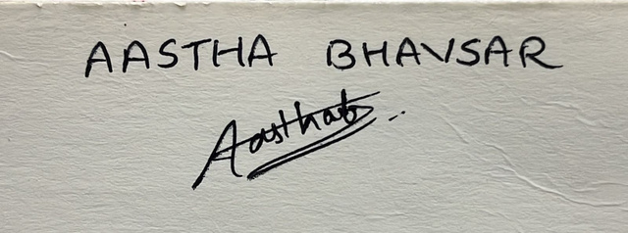


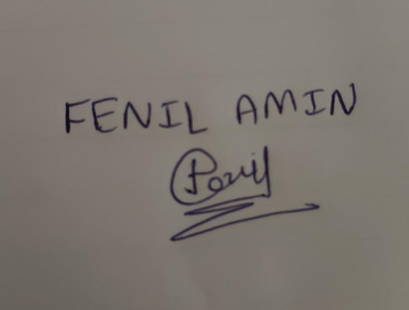
Signatures
1
DAIICT | 2024

Slide 4
Acknowledgement of any help
2
The main source of our code and concepts is the material posted on Google Classroom.
We used sources like some videos of NPTEL and other YouTube Videos.
Books which we used :
J. G. Proakis. Digital Communications. 4th edition. McGraw-Hill, 1995.
Dasari Sai Bhargav. Viterbi Decoding for Convolutional Codes.
DAIICT | 2024

Slide 5
Outline
3
History
Introduction to convolutional codes
Convolutional encoder
Convolutional codes representation and explanation with examples
-Generator Representation
-State Diagram Representation
-Trellis Diagram Representation
Decoding of convolutional codes
-Viterbi algorithm
Theoretical Analysis
Conclusion
DAIICT | 2024

Slide 6

History
4
Convolutional coding was first introduced in 1955 by Peter Elias. Initially, it was believed that these codes could be decoded with high accuracy, albeit at the cost of increased computation and delay.
However, in 1967, Andrew Viterbi discovered that convolutional codes could be decoded with maximum-likelihood using trellis-based decoders, thus introducing the Viterbi algorithm.
Subsequent to this, other decoding algorithms based on trellises, such as the BCJR algorithm, were developed.
DAIICT | 2024
Andrew Viterbi

Slide 7
Problem Statement
5
Reason for using Convolutional Codes:
In contrast to Block Codes, the Convolutional Codes work by encoding a continuous stream of information rather than discrete blocks.
These codes rely on memory, using previous bits to encode or decode subsequent ones. Within the Convolutional Coding, the output bits are calculated through logical operations involving the current bit in the stream and a limited number of preceding bits.
The Convolutional codes find use in applications where achieving high performance with minimal implementation complexity, often utilizing shift registers, is essential.
DAIICT | 2024

Slide 8
Objectives
6
Implement convolutional encoding with varying constraint lengths and code rates.
Modulate the encoded data using BPSK modulation.
Simulate transmission through an AWGN channel with varying SNR level.
Analyze and understand the difference in performance of soft decision and hard decision decoding methods under different SNR conditions.
DAIICT | 2024

Slide 9
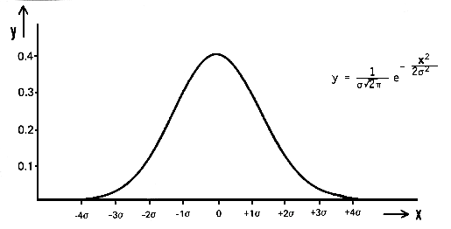
AWGN
7
Additive white Gaussian noise (AWGN) is characterized by being additive, having a constant power spectral density across frequencies (white), and following a Gaussian probability distribution.
The mean of AWGN is typically zero(0) and the variance of AWGN Is 𝜎2. And it is denoted by N(0, 𝜎2).
DAIICT | 2024
Probabilty distribution of AWGN :
(source : sfu.ca )

Slide 10
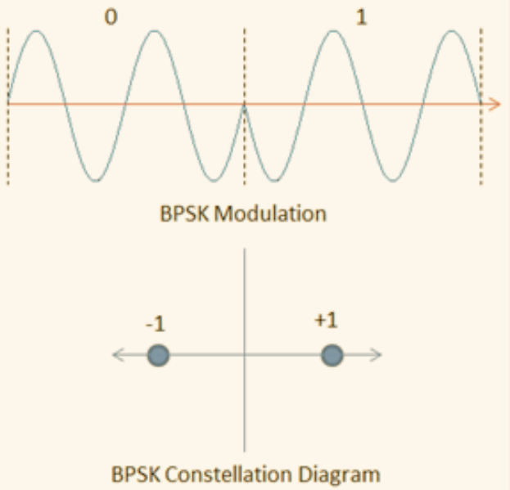
BPSK
8
BPSK stands for Binary Phase Shift Keying. It is a digital modulation scheme used in communication systems to transmit binary data (0s and 1s) over a communication channel.
A phase shift of 0 degrees is used to represent one symbol (e.g., 0), and a phase shift of 180 degrees (or π radians) is used to represent the other symbol (e.g., 1)
DAIICT | 2024
Image source: https://www.researchgate.net/figure/BPSK-modulation-and-constellation-diagram_fig1_338542687

Slide 11
Encoder Concept
9
Typically convolution codes are characterized or described as [n,k,Kc].
The incoming stream of bits is broken into segments of k bits and passed through the encoder, which n output bits.
These n output bits are generated by n generator polynomials with each generator polynomial having length Kc, where Kc is called constraint length.
The memory of the encoder is m, where m= Kc- k.
For the given encoder, the code rate is defined as r=k/n.
Further implementation and structure of encoder on : next slide
DAIICT | 2024

Slide 12
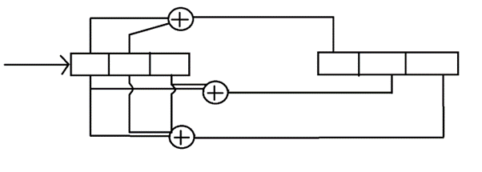
Encoder Structure
10
Here is an encoder with Kc= 3 , n = 3 , k= 1
g1 = [1 1 0] , g2 = [1 0 1] , g3 = [1 1 1 ]
DAIICT | 2024
|
|
image source: https://www.ee.iitb.ac.in/~sarva/courses/EE605/2014/slides/ViterbiAlgorithm.pdf

Slide 13
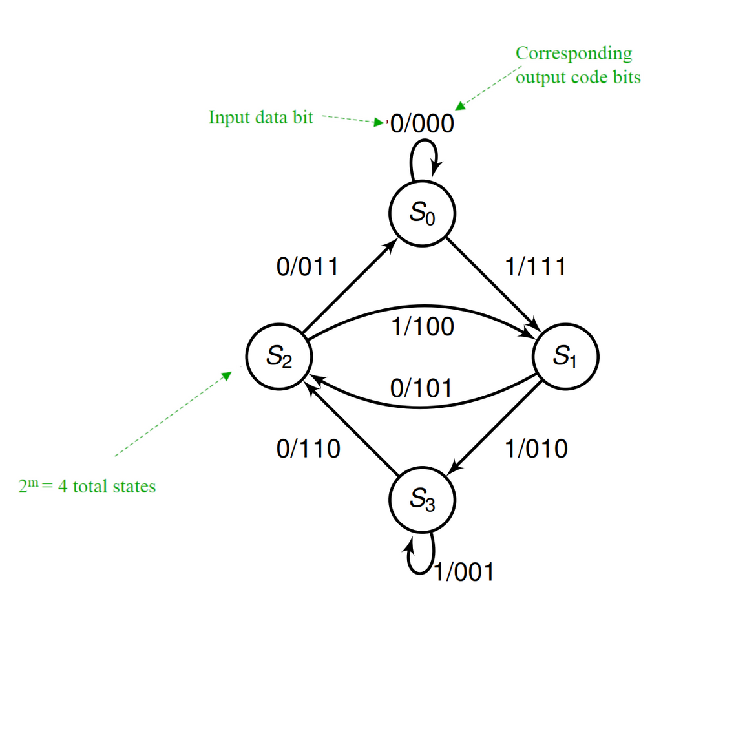
State Diagram Representation
11
DAIICT | 2024
image source: https://www.ee.iitb.ac.in/~sarva/courses/EE605/2014/slides/ViterbiAlgorithm.pdf

Slide 14
Decoder Concept
12
There are many decoding algorithms for the Convolutional code like Viterbi Algorithm, BCJR Algorithm (Bahl-Cocke-Jelinek-Raviv Algorithm), Fano Algorithm,Sequential Decoding Algorithms.
We will discuss only Viterbi algorithm .
DAIICT | 2024

Slide 15
Viterbi Algorithm
13
In Viterbi algorithm we use trellis data structure.
We can do HDD ( Hard Decision Decoding ) or SSD ( Soft Decision Decoding).
In case of , HDD we use Hamming Distance.
In case of , SDD we use Euclidean Distance.
Lets see the process of decoding using Viterbi algorithm.
suppose we are using encoder which we have in slide 10.
DAIICT | 2024

Slide 16
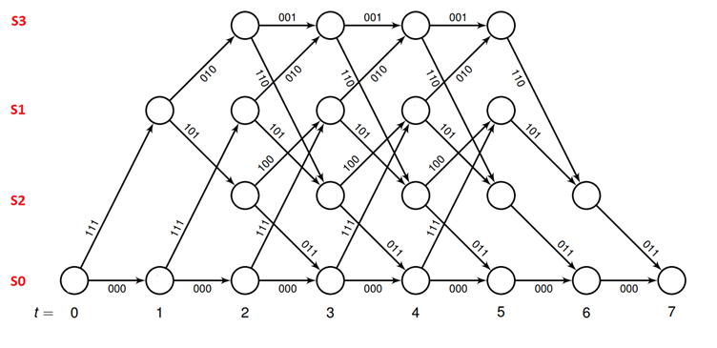
14
Suppose the received message is [110 110 110 111 010 101 101]
Step 1 :
Make a trellis from the state table.
We will assume that the initial state is zero and the path will also terminate to the all-zeros state.
So we will append 2 zeroes at the end of input so that it terminates at all-zeros state.
The Trellis will be:
DAIICT | 2024
110
110
110
111
010
101
101
image source: https://www.ee.iitb.ac.in/~sarva/courses/EE605/2014/slides/ViterbiAlgorithm.pdf

Slide 17
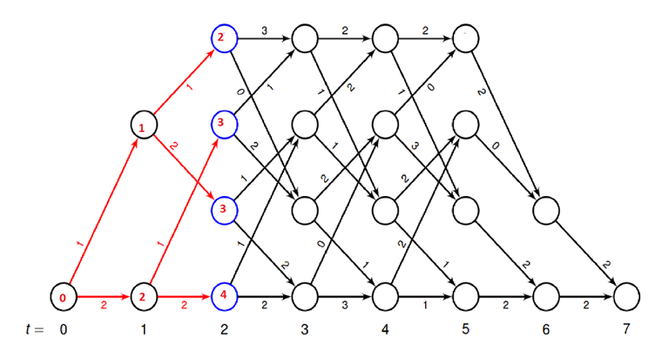
15
Step 2:
For each stage calculate Hamming Distance from previous stage’s stored values and store minimum for each state, discarding other paths.
DAIICT | 2024
Received Codeword:
110 110 110 111 010 101 101

Slide 18
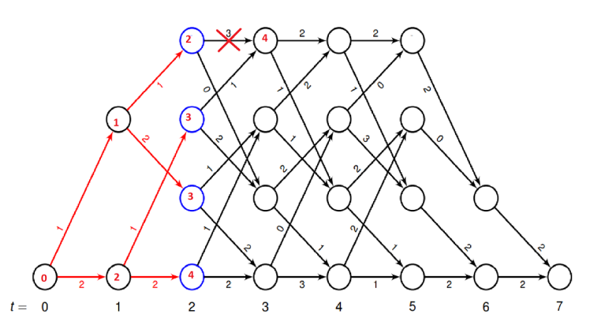
Discarding non optimal path:
16
DAIICT | 2024
110 110 110 111 010 101 101
At t=3, on state S0 there are two paths with cumulative hamming distance of 4 and 5, so we will discard the path having a hamming distance of 5, and we will do this for all states in trellis where there is more than 1 path.

Slide 19
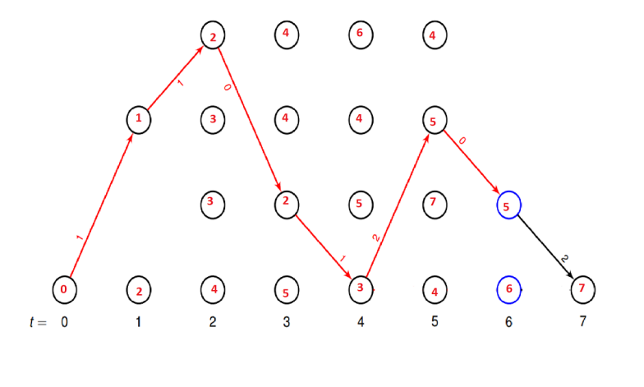
17
Keep doing this till last stage , and you will get only one survivor path which is most likelihood for our trasmitted codeword.
DAIICT | 2024
110 110 110 111 010 101 101

Slide 20
18
Step 3 :
Do backtracking and get the whole path.
in backtracking we compute the sum of the previous path matric and hamming distance for all states from which we can reach our current state of the current stage and we select the state with the minimum sum, we will keep doing this till the end of loop iteration i.e. till first stage.
After doing backtracking, we will have [111 010 110 011 111 101 011], Which has a minimum hamming distance from received message.
DAIICT | 2024
Here we have performed HDD by using hamming distance , similarly we can performe SDD by simply storing euclidean distance instead of hamming distance

Slide 21
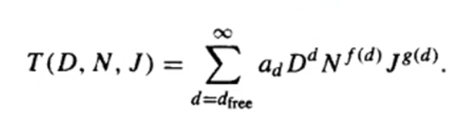
Transfer function
19
Transfer function is an algebraic representation of all the paths that start and end with zero state.
DAIICT | 2024
Here ,
Exponent of D ( d ) indicates the number of ones in output codeword.
Exponent of N ( f(d) ) indicates the number of ones in input block k bits - at a time .
Exponents of J ( g(d) ) indicates the number of branches spanned by the path.

Slide 22
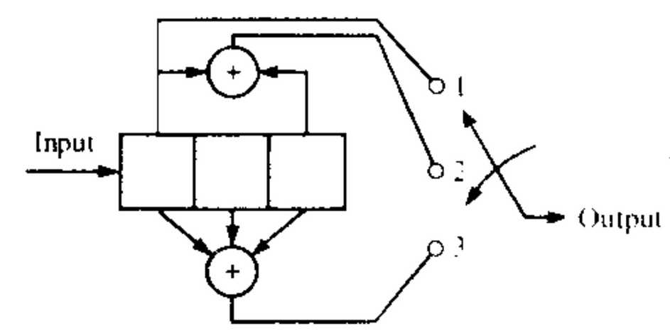
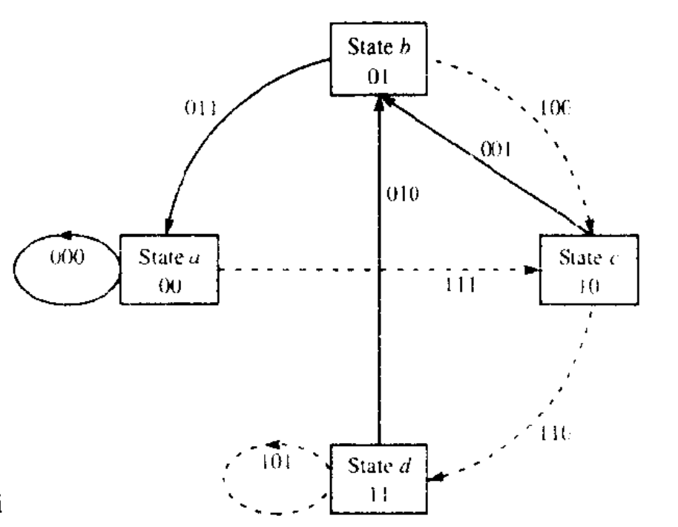
Method to calculate transfer function for given encode:
20
First Draw the state diagram for given encoder.
Encoder :
state diagram :
DAIICT | 2024

Slide 23
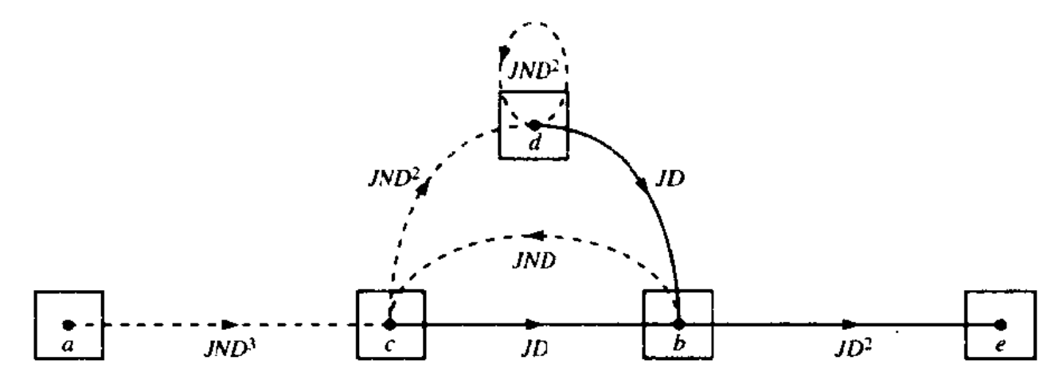
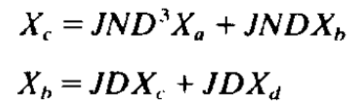
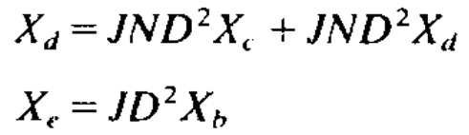
Split state a ( zero state ) into two states a ( start ) and e ( end )
and compute weight of all branches for new state diagram.
21
DAIICT | 2024
Write state equation for all states.

Slide 24
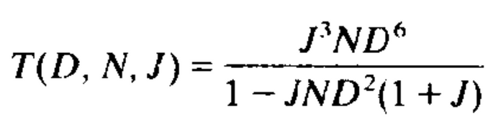
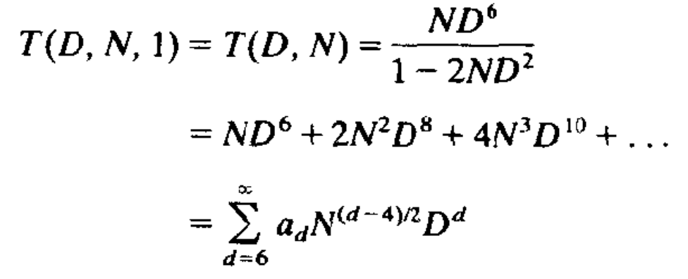
Transfer function T(D,N,J) =Xe/Xa
22
After solving ,
The factor J is important if we are transmitting a sequence of finite duration.
If we are transmitting an infinite length sequence , we may wish to suppress the dependence of T(D,N,J)
on the parameter J. this can be done by putting J=1;
DAIICT | 2024
in

Slide 25
Theoretical Analysis

Slide 26
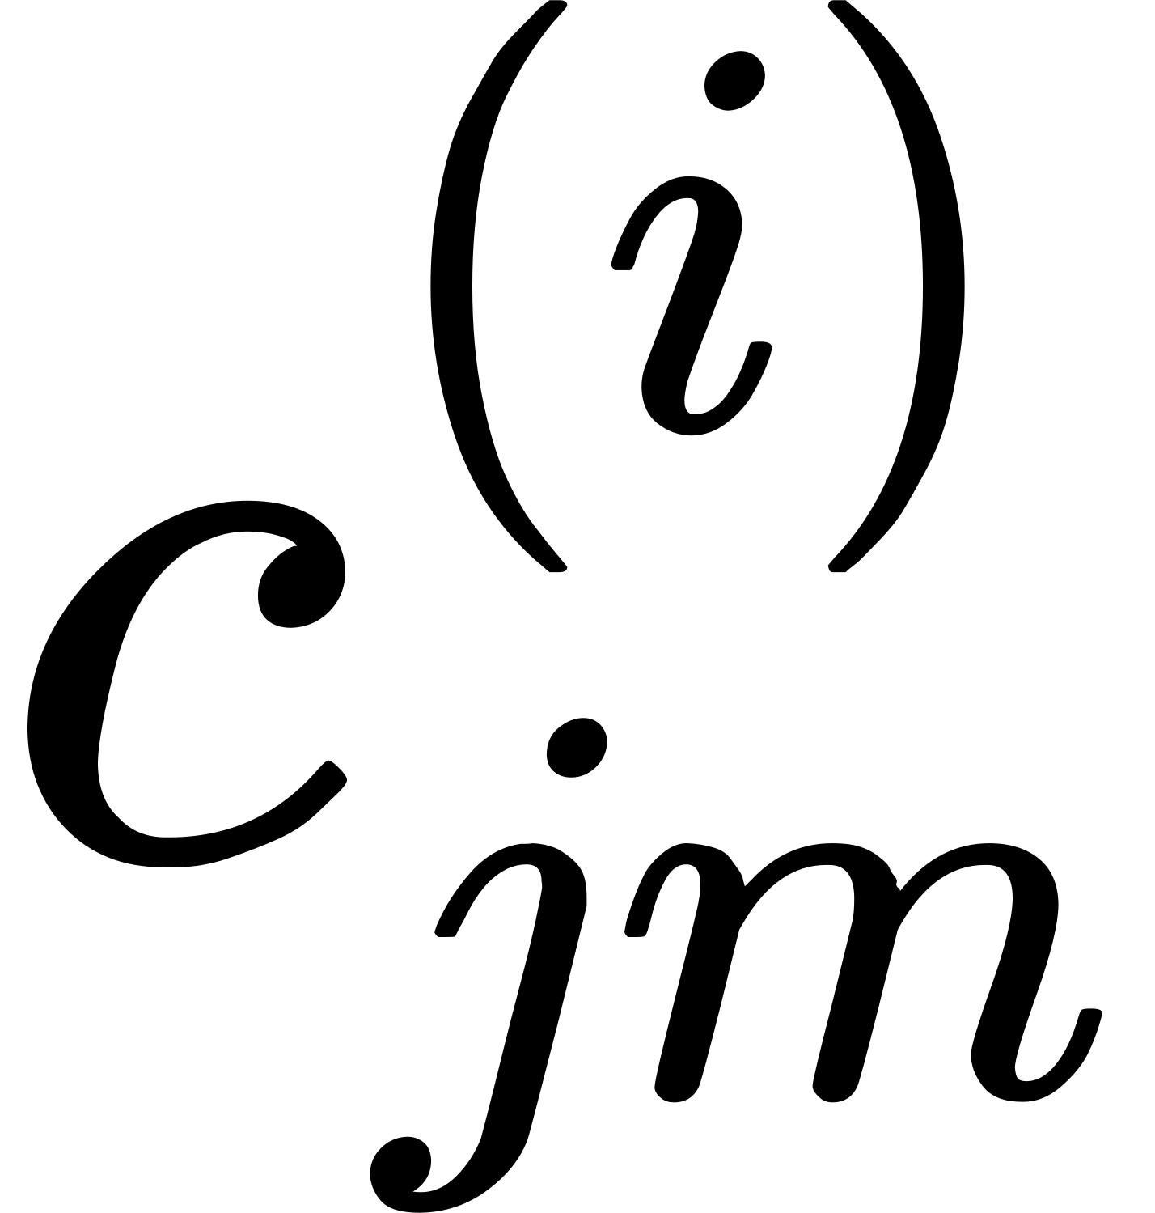
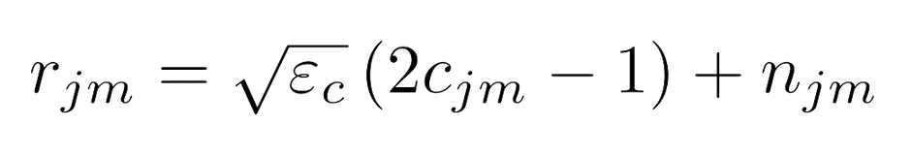
23
Probability of Error For Soft Decision Decoding:
In this section, we will try to estimate an upper bound for the error probability with soft decision Viterbi decoding.
For the simplicity of the derivation, we assume that all zero sequences are transmitted and we determine the probability of error in deciding in favor of another sequence.
We define as the coded binary digit for the mth bit for the jth branch of the ith path in the trellis for convolution code, and rjm as the output of the demodulator for the corresponding mth bit of the jth branch, where rjm is:
DAIICT | 2024

Slide 27
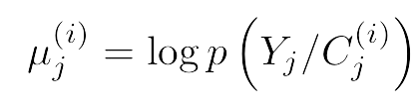
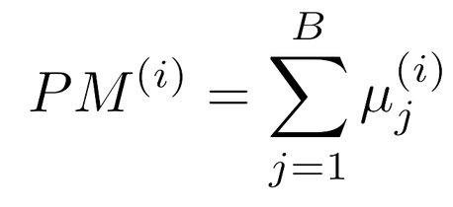
24
Where njm is represented as AWGN with mean 0 and variance 1, and εc is the transmitted signal energy for each code bit.
The “Branch metric is defined for the jth branch of the ith path through the trellis as the logarithm of the joint probability of the sequence {rjm, m = 1, 2, 3} conditioned on the transmitted sequence {cjm, m = 1, 2, 3} for the ith path.
Furthermore, “Path metric” for the ith path consisting of B branches through the trellis is defined as:
DAIICT | 2024

Slide 28
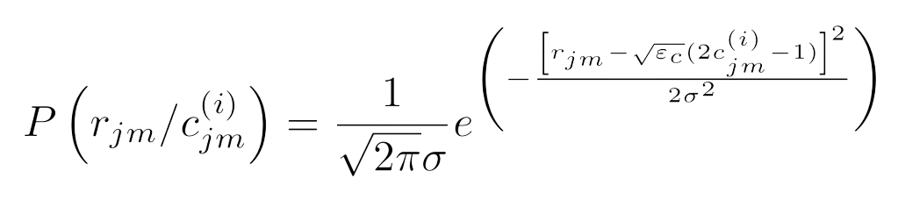
25
For the soft decision decoding, the channel adds AWGN to the signal.
Probability of getting r (i) jm given c (i) jm is equal to probability of noise equal to
Since noise is normally distributed, we can directly compute it using the formula for the probability density function of a normally distributed variable.
DAIICT | 2024

Slide 29
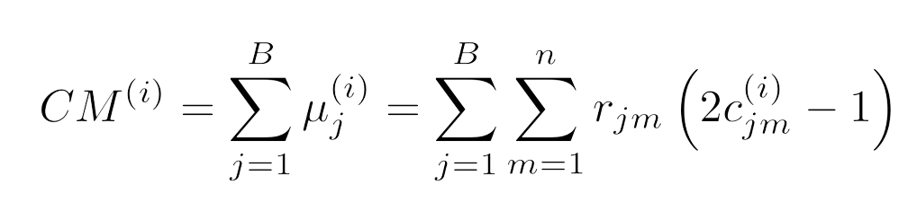
Correlation Metric :
26
Correlation metric for the ith path is defined as sum of branch metric for that path.
Suppose i=0 is all zero path and i=1 is another path that merge with all zero path after some transitions.
DAIICT | 2024

Slide 30
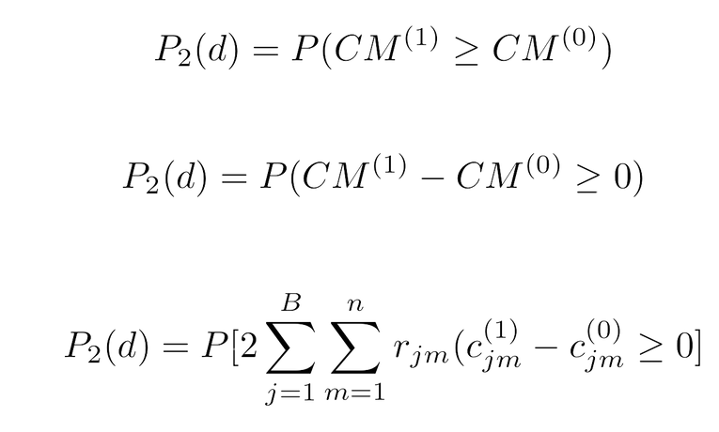
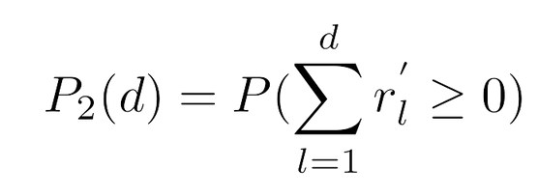
First event error probability:
27
We define the first-event error probability as the probability that another path merges with all zero path at node B which has metric that exceeds the matric of all zero path for the first time.
Suppose the incorrect path has i=1, which merges with the all-zero path and differs from the all-zero path in d-bits.
We define pairwise error probability as the probability of the correlation metric of the incorrect path being greater than the correct(all zero) path,
Since the coded bits in two paths are identical except in d positions only d terms will left.
DAIICT | 2024
The r ′l are the independent and identically distributed gaussian radnom variables with the mean − √ εc and variance No/2 .

Slide 31
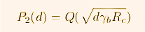
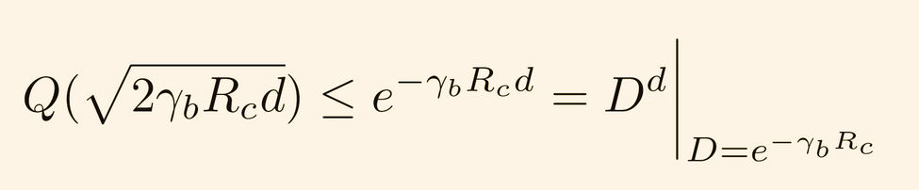
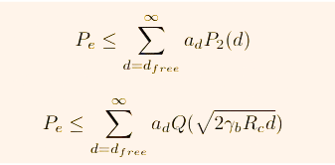
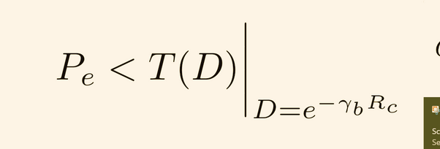
Upon solving the previous equation we get, (proof for the same is given in the attached pdf)
There are many possible paths with different distances that merge with the all-zero path at a given node B. We can sum the pairwise error probability over all paths to obtain an upper bound on the first-event error probability in the form
28
Where γb= εb/N0 is received SNR per bit and Rc is code rate
DAIICT | 2024
We can the upper bound of Q function using Chernoff bound as:
Where ad denotes the number of paths of distances ‘d’ from the all-zero path that merges with the all-zero path for the first time.
Hence,

Slide 32
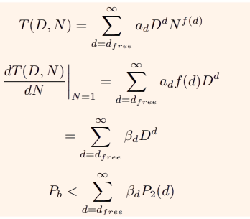
Bit error probability
29
If we multiply the pairwise error probability P2(d) by the number of incorrectly decoded information bits for the incorrect path at the node where they merge we obtain the bit error rate for that path.
We know that the exponent in the factor N contained in the transfer function T(D,N) indicate the number of information bit errors in selecting an incorrect path that merges with all-zero path at some node B.
DAIICT | 2024

Slide 33
Hard decision decoding
30
We saw how to find first event error probability in SDD.
Similarly we can find first event probability for Hard Decision Decoding.
DAIICT | 2024

Slide 34
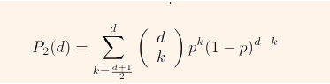
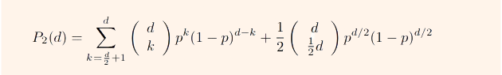
Bitwise error probability
31
Bitwise error probability We assume that we transmit all-zero path.
Suppose i=0 is all zero path and i=1 is another path that merges with all zero path after some transitions.
Path i=1 contains d ones.
So, if d is odd, path 1 will be chosen over path 0 if there are more than (d+1)/2 ones
and if d is even, path 1 will be chosen over path 0 if there are more than d/2 ones and there is half probability that path 1 will be chosen when the number of 1’s equal to d/2.
DAIICT | 2024

Slide 35
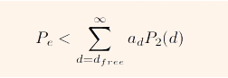
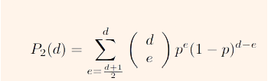
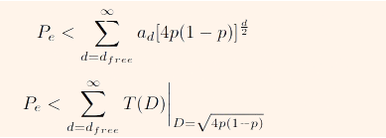
There are many possible paths with different distances that merge with the all-zero path at given node.
Therefore, there is no simple exact expression for the first-event error probability.
However, we can provide an upper bound as we did in SDD.
We can provide an upper bound of P2(d) :
32
DAIICT | 2024

Slide 36
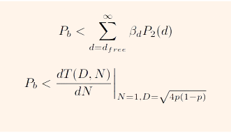
33
If we multiply the pairwise error probability P2(d) by the number of incorrectly decoded information bits for the incorrect path at the node where they merge we obtain the bit error rate for that path.
We will use the transfer function to get information about the number of incorrectly decoded bits.
DAIICT | 2024

Slide 37
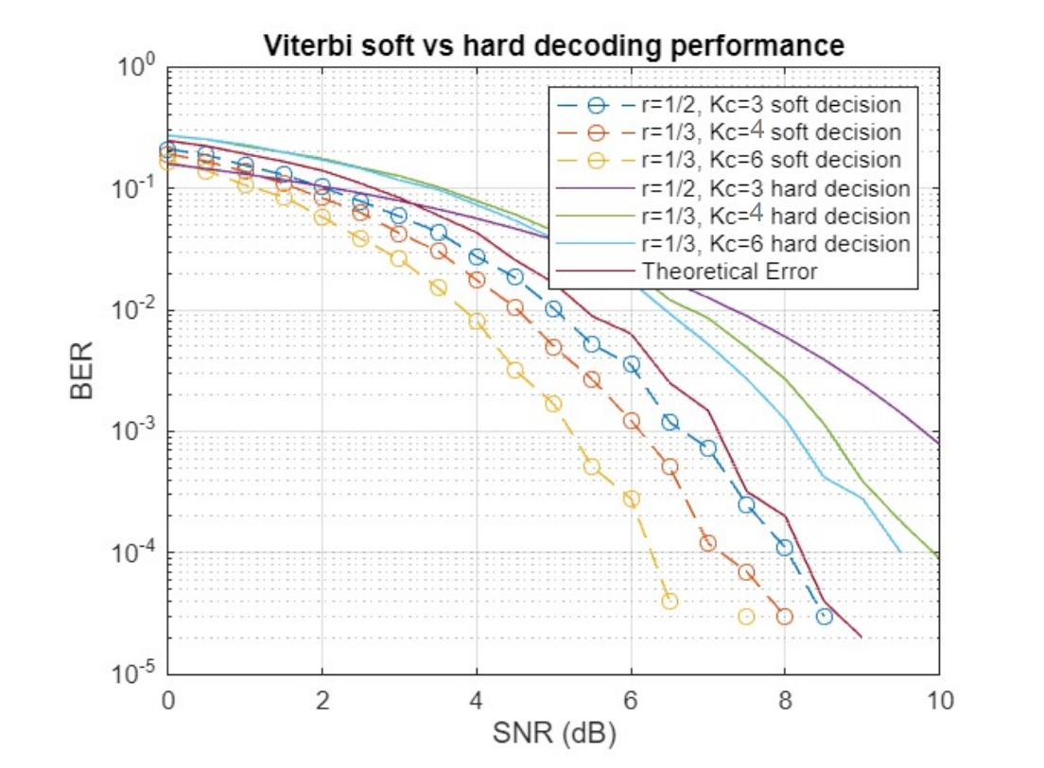
34
RESULTS
SIMLUATION RESULT COMPARISON FOR THE DIFFRENT VALUES OF [n,k,Kc]
DAIICT | 2024

Slide 38
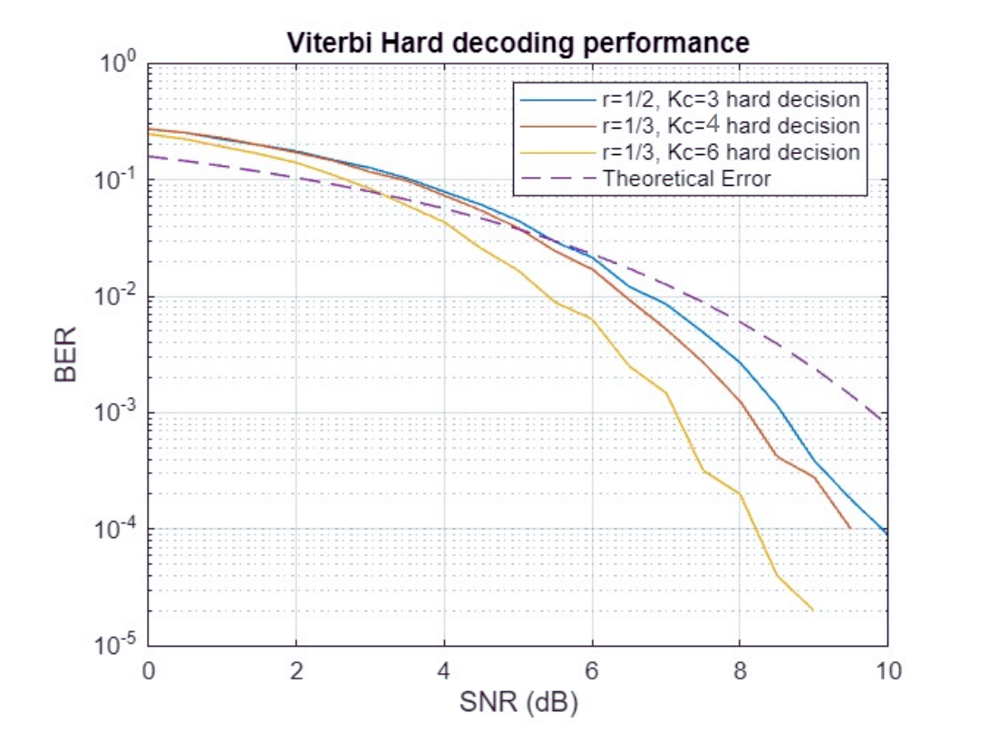
RESULTS
35
SIMLUATION RESULT COMPARISON FOR THE DIFFRENT VALUES OF [n,k,Kc]
DAIICT | 2024

Slide 39
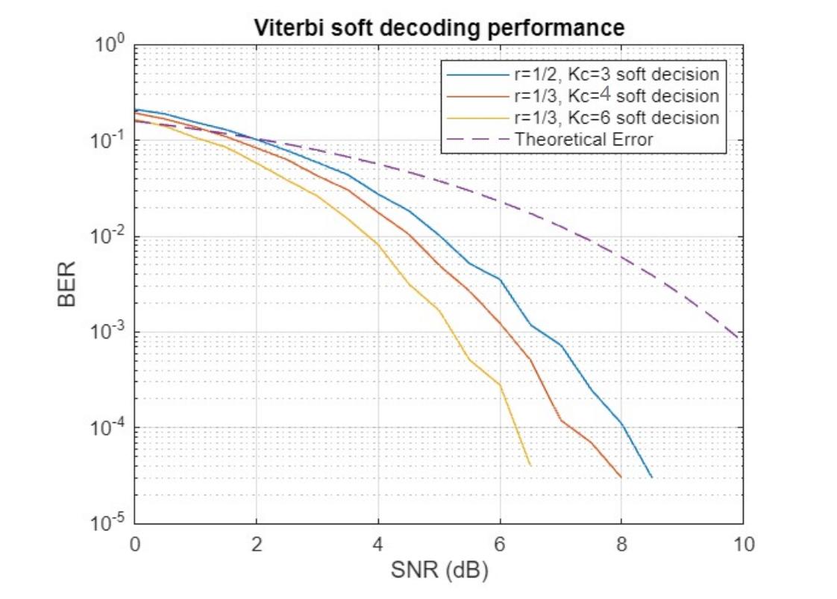
RESULTS
36
SIMLUATION RESULT COMPARISON FOR THE DIFFRENT VALUES OF [n,k,Kc]
DAIICT | 2024

Slide 40
Conclusion
37
Beyond a certain point, decreasing R(CodeRate) too much can lead to inefficiency in the use of the channel bandwidth or resource, or it may adversely impact the overall throughput of the communication system.
As the memory of the register increases, more number of previous input bits is used to encode each new bit.
This additional information increases the accuracy and decreases BER for a given value of code rate for the encoded data.
With higher Kc, the decoder can better detect and correct errors introduced during transmission due to noise, leading to a lower BER at a given signal-to-noise ratio(SNR)
By taking the Euclidean distance between the expected and received voltages, we also take into account the information contained in the received bit where as in the hard decoding where we use a threshold voltage value to map received voltages to bits and therefore there is lose of information during the conversion. Therefore soft decision decoding provides better path metric and therefore is able to perform better than hard decoding.
DAIICT | 2024

